Slide 1

KenyansDoCare
We are the people: Let justice be our shield and defender
Declaimers: This is for purely learning purposes, in case your relatives, friends or your political party affiliated leaders appear here, know that this is a learning sample and no need to sue me. regards.
By Kenedy Musyoki

Slide 2


Opening Quote
“In matters of truth and justice, there is no difference between large and small problems, for issues concerning the treatment of people are all the same.”
-Albert Einstein

Slide 3
Problem Statement
In Kenya, corruption has been idolized with judicial system being silenced with threats or underfunding leading to “delayed” actions taken. As a results, few elites in society continue to squander public resources to finance their lavish life. In the end, the common citizen will suffer with more taxes imposed on them to continue sustaining their “country’s” growth. Similarly, life become unbearable. Therefore, to solve this issue we need a simple system that would help in publishing the list of suspects and action taken by them; with this Kenyans will keep the executive and judicial system agencies in checks ensuring that all corrupt suspects and criminals are punished and the public funds and resources recovered.

Slide 4
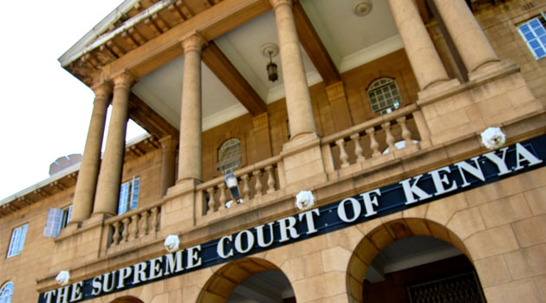
Solution Statement
The system, KenyansDoCare seeks to address the problem of government accountability by ensuring that all exposed suspects have been brought to justice.

Slide 5
Solutions
Ease of navigation
Aesthetic interface and layout

Slide 6
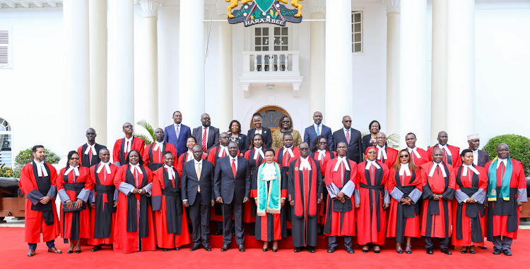


MVP
Public users can access the website and view the list of the displayed suspects.
They can report report suspect ranging from politicians, police officers, business men and anybody else involved in squandering or misusing public resources.
The reporting can be done through the contact us section, where there is a form to fill.
Once posted, the admin will do a background check before publishing the suspect.
The admin will then publish the suspects once convinced to allow the DCI to do their work.
The updates from the DCI are apprehended, under Investigation, or incarcerated.
The user can only report incident.
QUICK TIP
Try right clicking on a photo and using "Replace Image" to show your own photo.

Slide 7
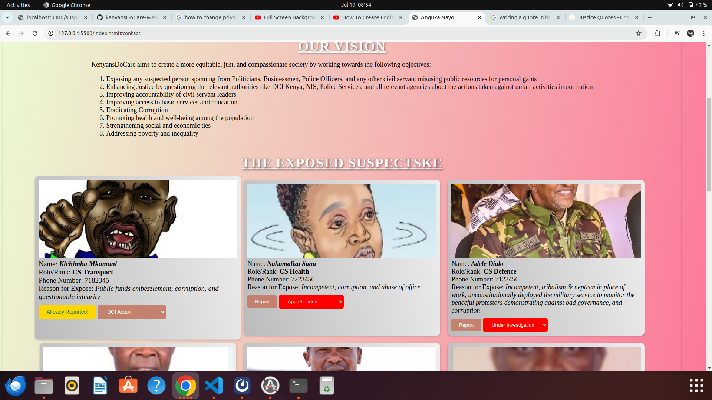
KenyansDoCare Demo

Slide 8



Technologies used
| Html for marking the page.
| db.json
| css for styling the page
| JavaScript for DOM manipulation and doing data fetching from json

Slide 9
Future plans
| Cloud Hosting
| Add several features to the system such as hiding the suspect from the user interface once cleared
| Keep track of the system analytics

Slide 10
ANY QUESTIONS?

Slide 11
Thank you Patriots!

